Slide 1
Swarm Intelligence

Slide 2
An Overview
Real world examples
Theory of Swarm Intelligence
From Insects to Realistic AI Algorithms
Examples of AI applications

Slide 3
Real World Examples

Slide 4
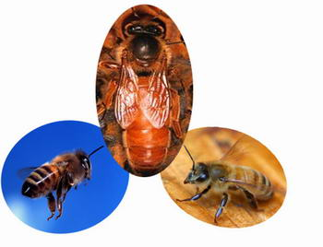
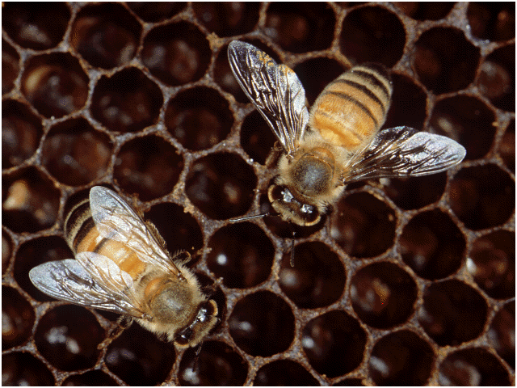
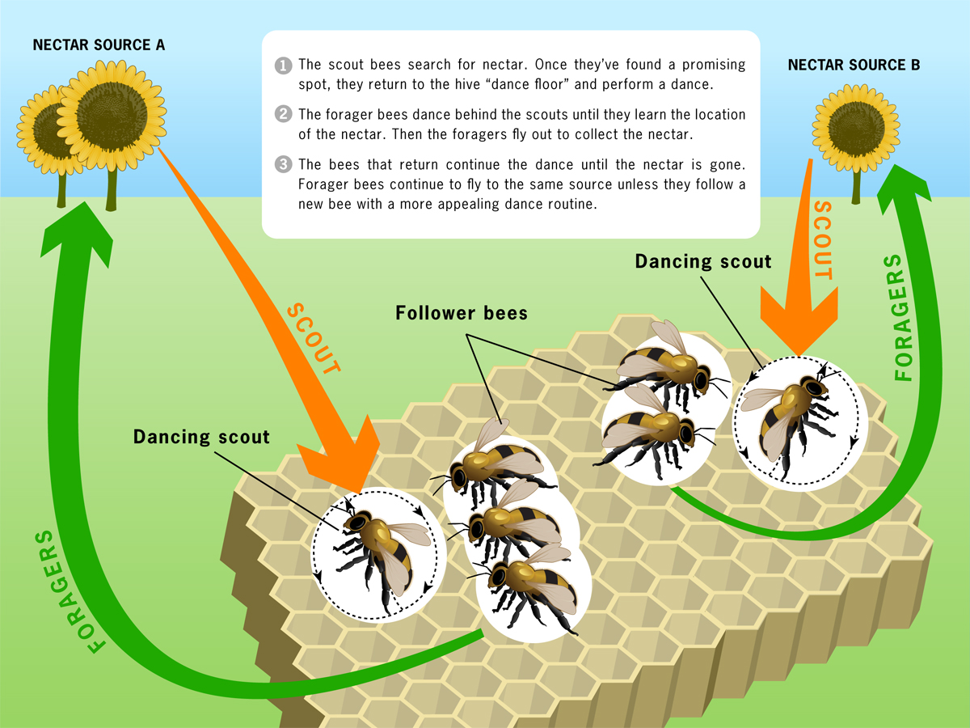
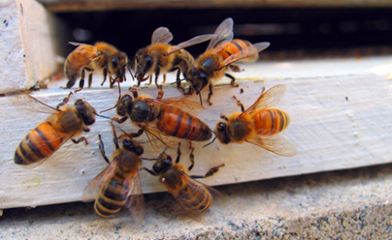
Bees
Notes:
4
蜜蜂是一种过集体生活的昆虫，在一群蜜蜂中有一只蜂王（蜂）和许多工蜂以及少数的雄蜂。工蜂在一个蜂群中要算是最勤劳了，它担负着采蜜，侦察、守卫、清理蜂箱和饲养小蜜蜂等等的工作。
蜂巢内有上万个六棱柱体平行地排列着，每个棱柱体的底都是由三个菱形组成的.数学证明，只有采用这样大小的角度，蜂窝用的材料才最省，而容积却最大

Slide 5
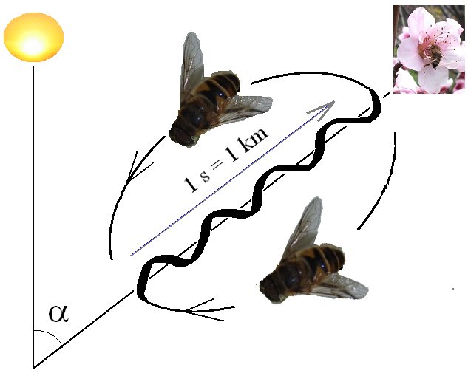
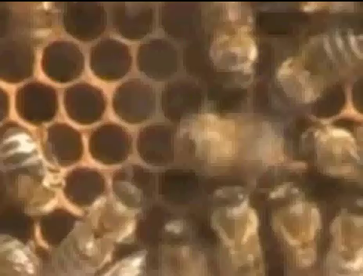
Bees
Colony cooperation
Regulate hive temperature
Efficiency via Specialization: division of labour in the colony
Communication : Food sources are exploited according to quality and distance from the hive
Notes:
5
蜜蜂行为的特点是:①社会性。蜂王、雄蜂和工 蜂有不同的行为，分工协作;②阶段性。工蜂之间 有大体上按日龄顺序的分工;③机动性。工蜂可根据 集内外变化了的环境条件提前或推迟从事某项工作， ④多样性。同一日龄的工蜂具备从事多种工作的能 力。
碰 胜、光、声音、电磁、化学品、物质的气味等.刺激到专 门的感觉细胞.蜜蜂就产生一定的反应活动
在爬行中接触到外界事物的刺激， 通过神经反应产生各种行为。如调节蜂巢温、湿度的 活动，扇风通风活动，接收花蜜，探查进巢蜂，攻击 “人俊者”，清扫巢房等等。
当春暧花开天气温暖的季节，一些作侦察工作的蜜蜂就飞出箱外去寻找蜜源。当侦察兵在外面找到了蜜源，它就吸上一点花蜜和花粉，很快地飞回来。回到蜂群后，它就不停地跳起舞来，你不要以为这仅仅是一种欢乐的表现，其实这舞蹈是蜜蜂用来表示蜜源的远近和方向的。蜜蜂舞蹈一般有圆形舞和８字形舞两种。如果找到的蜜源离开自己不太远，就在巢牌上（蜜蜂用来装蜜孵育小蜜蜂和住宿的地方）表演圆形舞：如果蜂蜜离的比较远就表演８字舞。在跳舞时如果头向着上面，那么蜜源就是在对着太阳的方向，要是头向着下面，蜜源就是在背着太阳的方向。
原来，蜜蜂的“舞蹈”是同声音一道起到语言作用的。在“舞蹈”的过程中，蜜蜂翅膀上同时发出类似机器脚踏时所发出的微弱的噼啪声，在几厘米的范围内可以听得很清楚。这种声音具有指示蜜源的作用，侦察工蜂和采集工蜂用这种“语言”可以相互交谈。这种声音持续越长，表示蜂窝到蜜源的距离越远

Slide 6
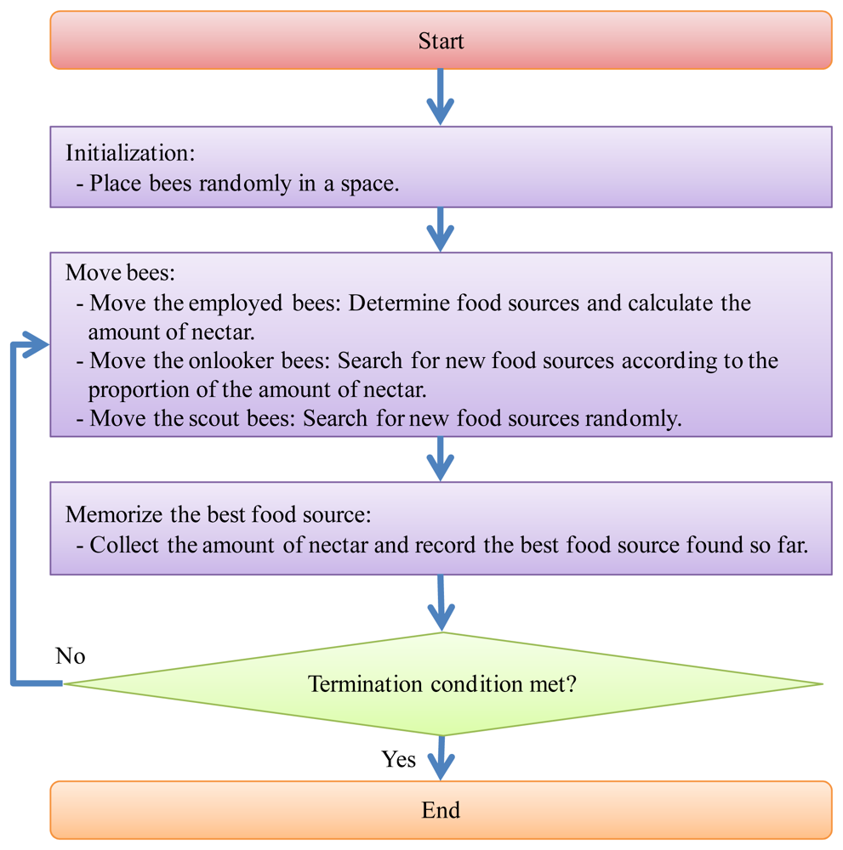
Artificial Bee Colony Algorithm

Slide 7
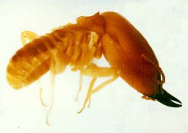
Termites

Slide 8

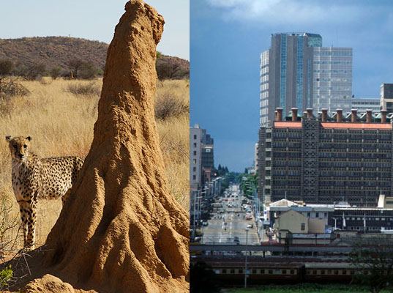
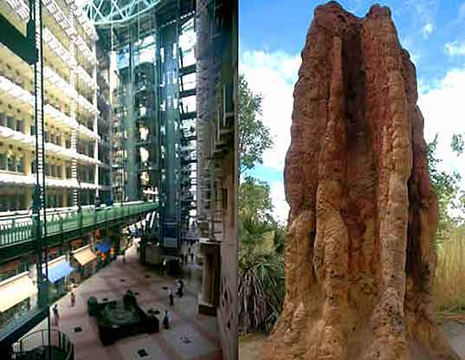
Termites
Cone-shaped outer
walls and ventilation ducts
Brood chambers in central hive
Spiral cooling vents
Support pillars
Biomimicry’s Cool Alternative: Eastgate Centre in Zimbabwe
The fungus must be kept at exactly 87 degrees F (30.5C), while the temperatures outside range from 35 degrees F at night to 104 degrees F during the day
Notes:
8
Possibly remove termite section if time is not an issue since we don't know a lot about them... or their function.

Slide 9

UNDERGROUND CITY
Ants subterranean structures revealed

Slide 10
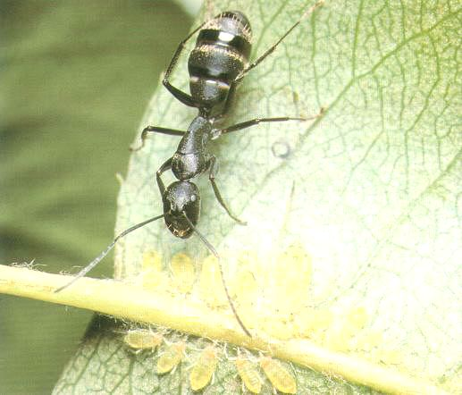
Ants
Notes:
10
Focus of presentation.
Why?
Easy to study
Predictable..
Ants in Pants was my favorite game

Slide 11

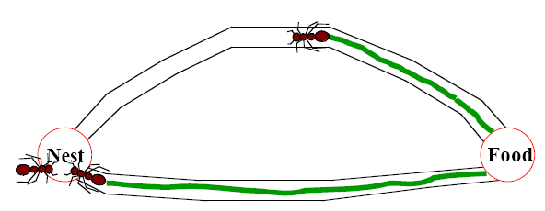
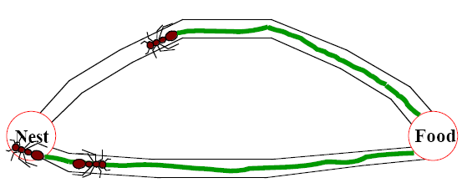
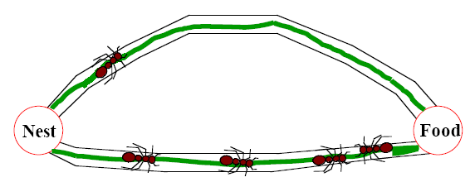
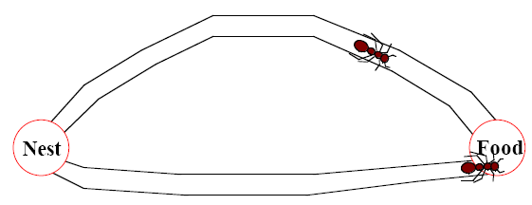
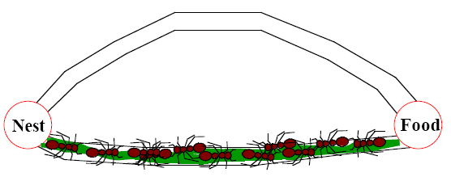
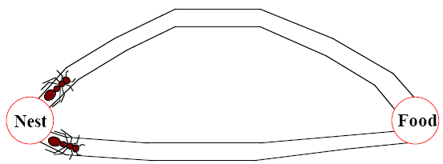
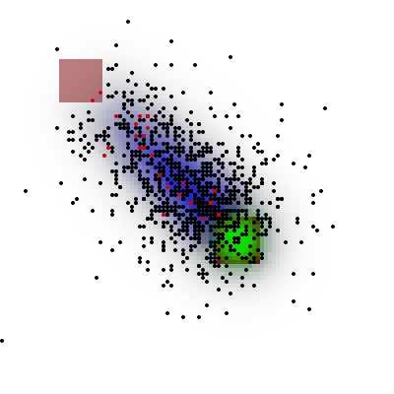
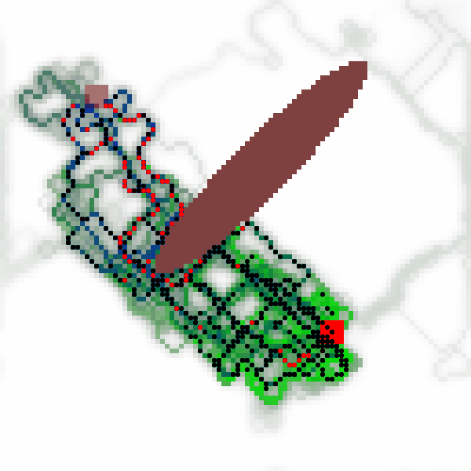
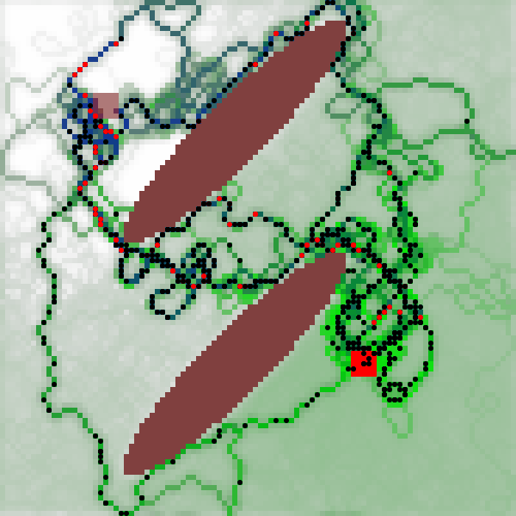
Ants
Organizing highways to and from their foraging sites by leaving pheromone trails
Notes:
11
Possibly add pic on page 30... some side effects are that it is redundent?
division of labour : hunters and nest workers

Slide 12
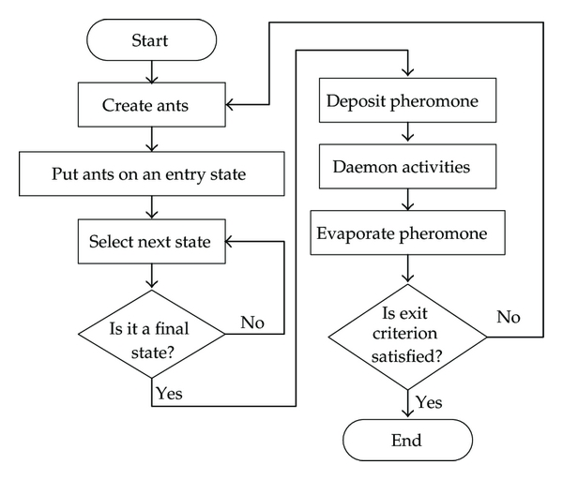
Ant Colony Optimization

Slide 13
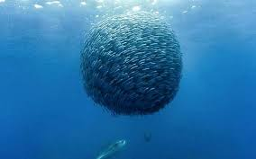
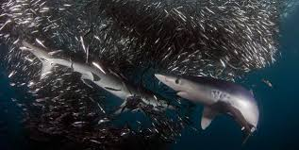

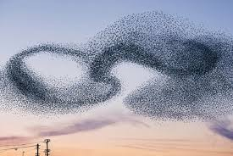
Fish Schooling & Bird Flocking

Slide 14
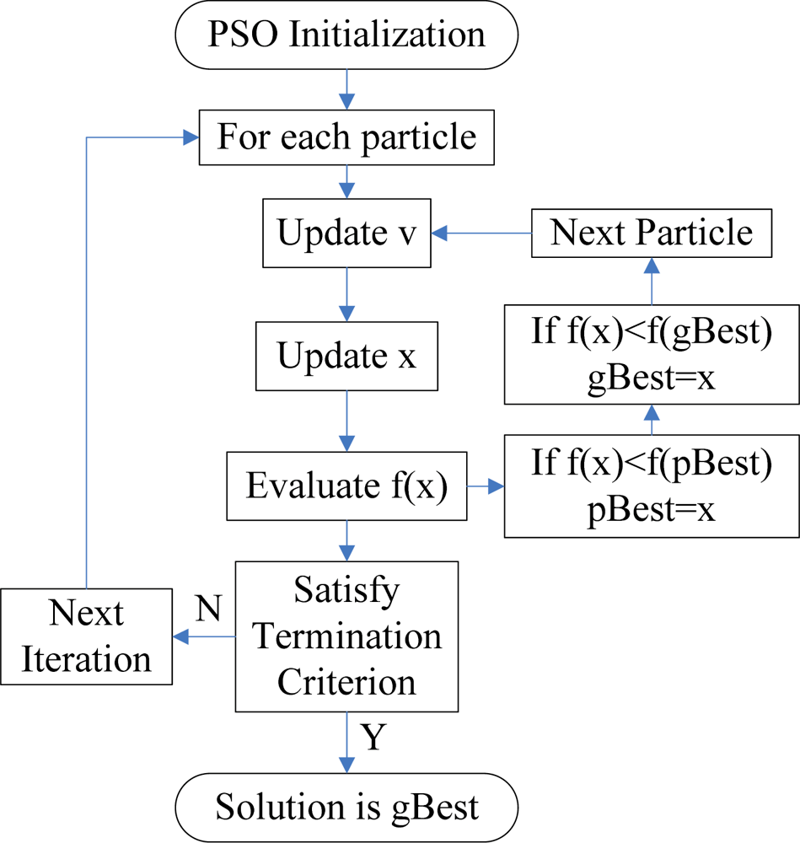
Particle swarm optimization

Slide 15
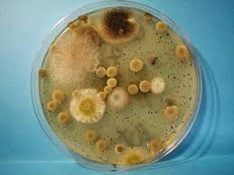
Bacterial

Slide 16
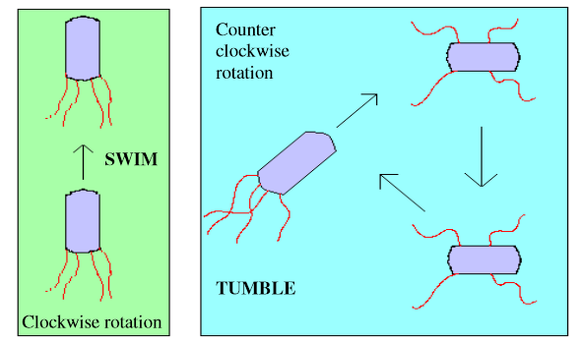
Bacterial Foraging Optimization

Slide 17

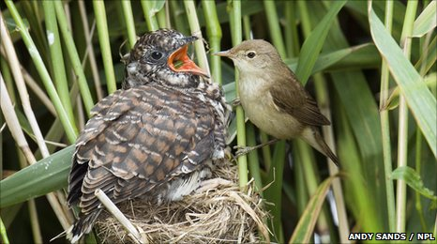
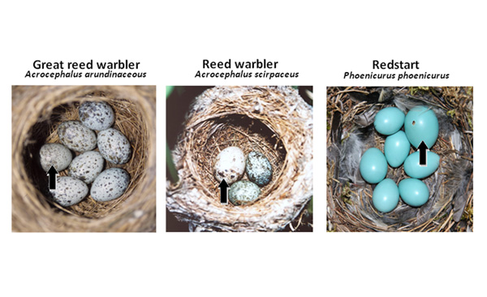
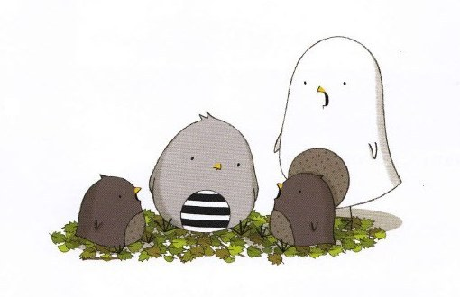
Cuckoo
reed warbler(芦苇莺)

Slide 18
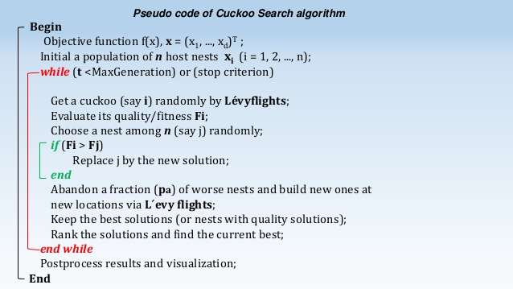
Cuckoo search

Slide 19
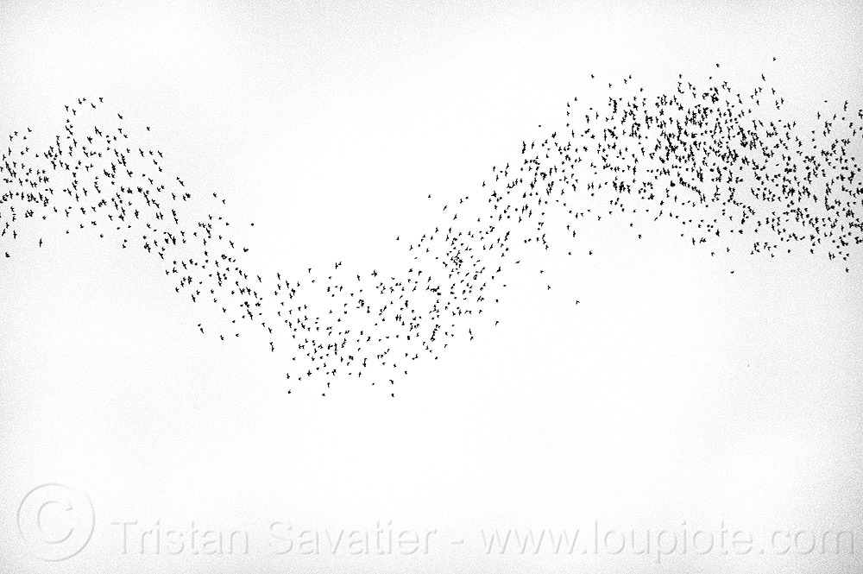
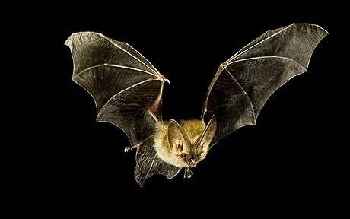
Bat

Slide 20
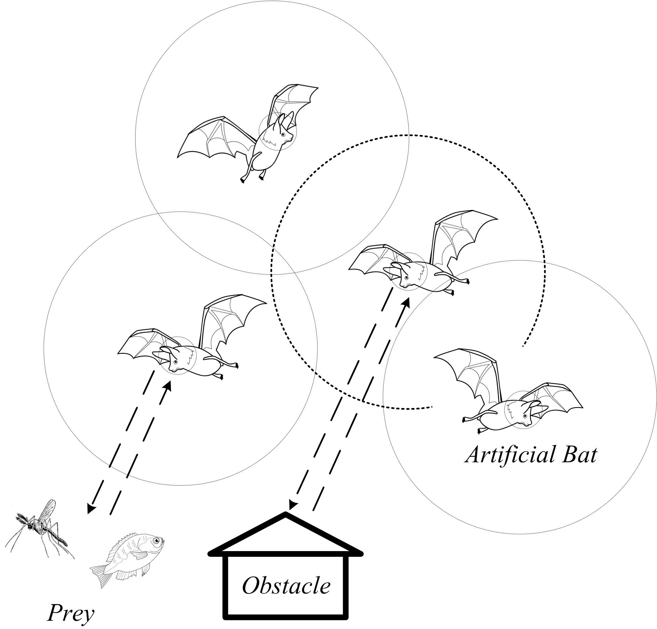
Bat algorithm
BA automatically balances exploration (long-range jumps around the global search space to avoid getting stuck around one local maxima) with exploitation (searching in more detail around known good solutions to find local maxima) by controlling loudness and pulse emission rates of simulated bats in the multi-dimensional search space.

Slide 21
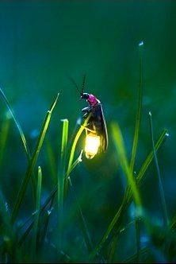
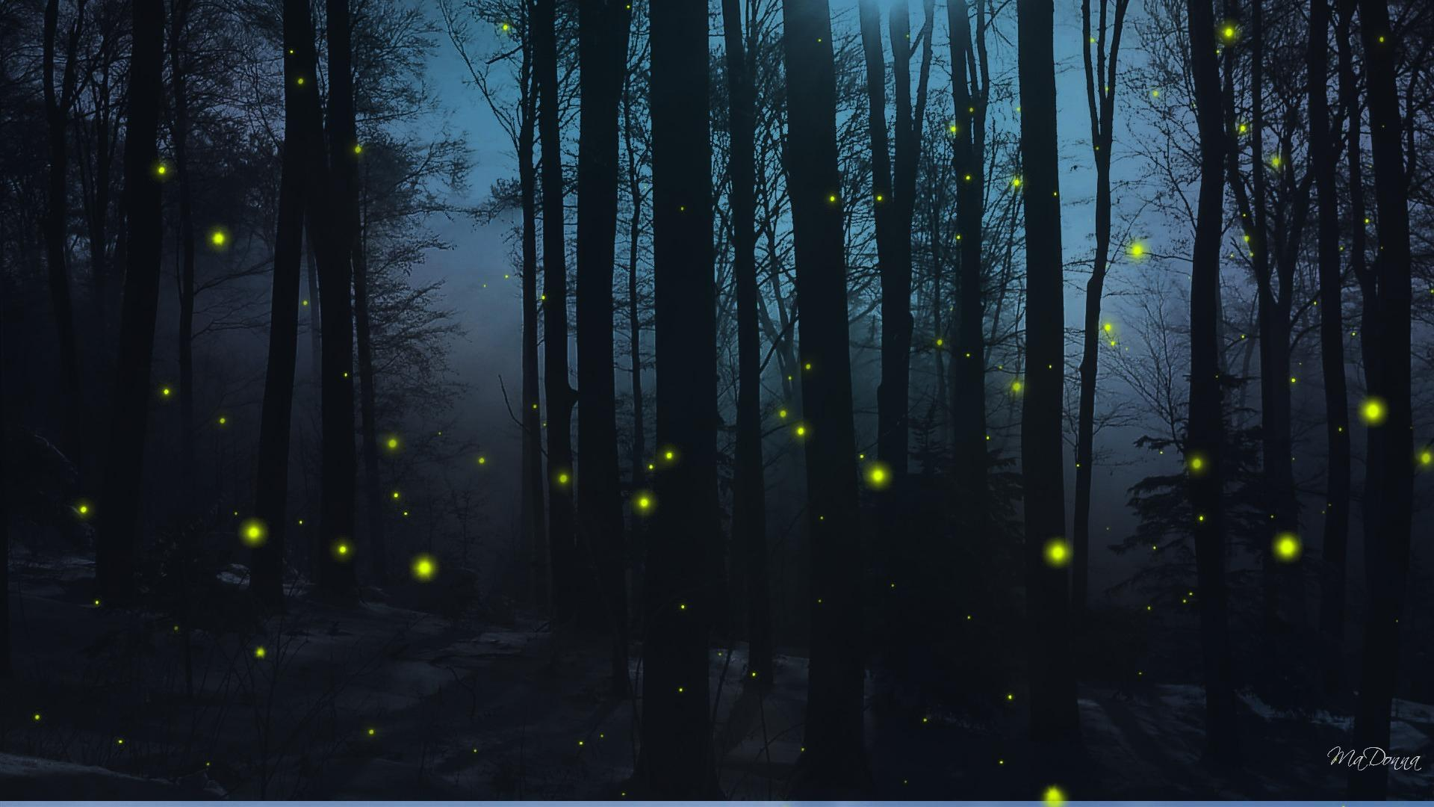
Firefly

Slide 22
Firefly algorithm
Inspired by the flashing behaviour of fireflies.
1. All fireflies are unisexual, so that any individual firefly will be attracted to all other fireflies;
2. Attractiveness is proportional to their brightness, and for any two fireflies, the less bright one will be attracted by (and thus move towards) the brighter one; however, the intensity (apparent brightness) decrease as their mutual distance increases;
3. If there are no fireflies brighter than a given firefly, it will move randomly.

Slide 23
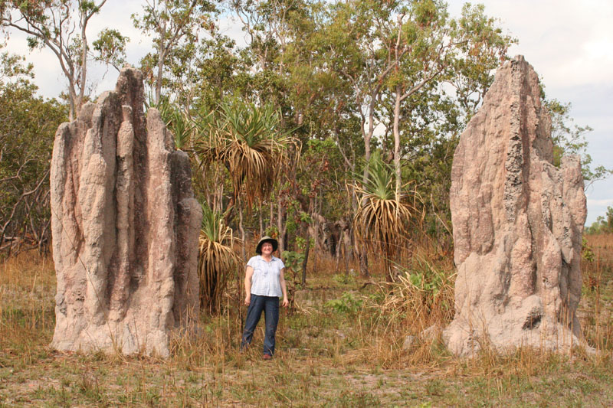
Swarming is Powerful
Swarms can achieve things that an individual cannot

Slide 24
Powerful … but simple
Problem solving benefits include:
Flexible
Robust
Decentralized: No central control
Self-Organized
Notes:
24
Page 19
flex: take away major or minor and they compensate
robust: recover from changes in the environment shown in just a couple of slides
decentralized: In the case of ants Individual ants have their own agenda yet the cooperation and integration of these actions needs no supervisor.
self-organized: complex issue that will be discussed shortly.

Slide 25
Harness this Power out of Simplicity
Technical systems are getting larger and more complex
Global control hard to define and program
Larger systems lead to more errors
Swarm intelligence systems are:
Robust
Relatively simple (How to program a swarm?)
The complexity and sophistication of Self-Organization is carried out with no clear leader

Slide 26
What is SI
SI is the collective behavior of decentralized, self-organized systems, natural or artificial.
SI is about large groups of agents/robots in which the individuals are simple and rather unintelligent. However, through local interactions between these individuals, intelligent group behavior emerges.

Slide 27
Swarm Intelligence in Theory

Slide 28
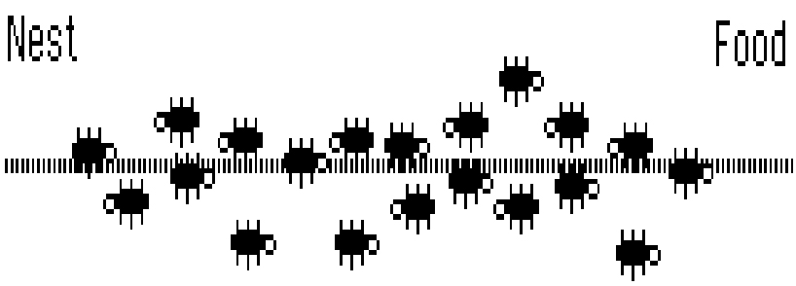
An In-depth Look at Real Ant Behaviour
Notes:
28
We want to talk in depth about how the algorithm works here

Slide 29
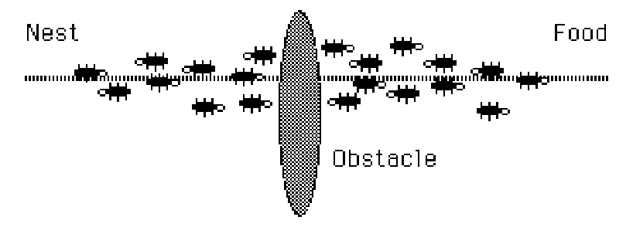
Interrupt The Flow

Slide 30
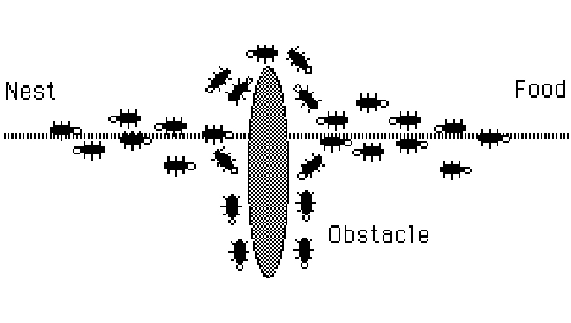
The Path Thickens!

Slide 31
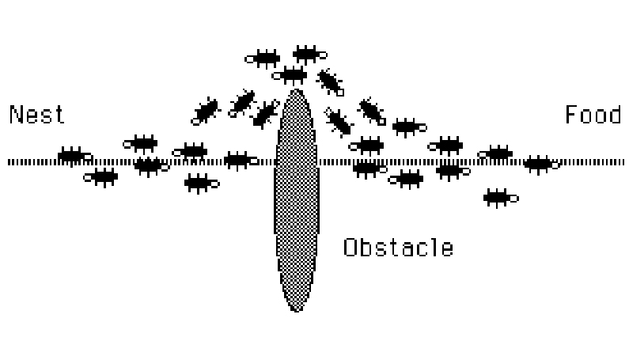
The New Shortest Path

Slide 32
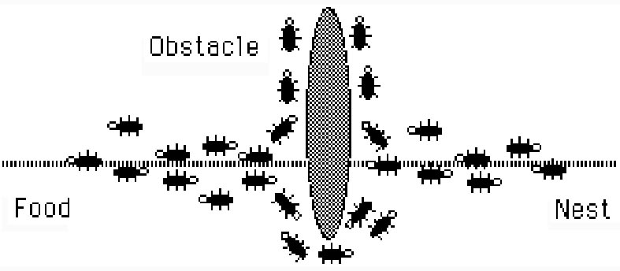
Adapting to Environment Changes
Notes:
32
With a change in the environment, swarm intelligent systems will adapt to this change and find the new optimal solution.
This is achieved because ants choose to follow a path withcertain probability, therefore ants are always re-testing paths that were previously found to ineffiecient.

Slide 33
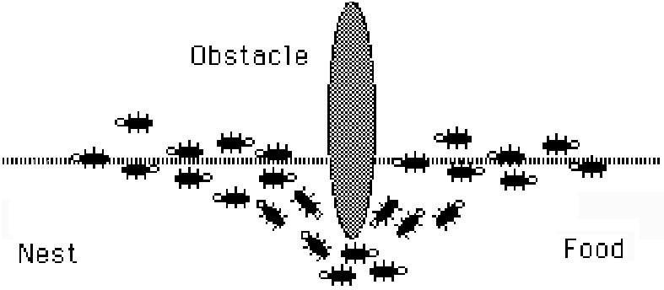
Adapting to Environment Changes
Notes:
33
Fully optimal solution found again.

Slide 34
Ant Pheromone and Food Foraging Demo

Slide 35
Problems Regarding Swarm Intelligent Systems
Swarm Intelligent Systems are hard to ‘program’ since the problems are usually difficult to define
Solutions are emergent in the systems
Solutions result from behaviors and interactions among and between individual agents
Notes:
35
read in book....
defining the problem and discovering the solution....
look in book for more information

Slide 36
Four Ingredients of Self Organization
Positive Feedback
Negative Feedback
Amplification of Fluctuations - randomness
Reliance on multiple interactions

Slide 37
Properties of Self-Organization
Creation of structures
Nest, foraging trails, or social organization
Changes resulting from the existence of multiple paths of development
Non-coordinated & coordinated phases
Possible coexistence of multiple stable states
Two equal food sources
Notes:
37
Page 12
spatiotemporal in other words...
bifurcations in other words...
Acceptable goal states

Slide 38
Types of Interactions For Social Insects
Direct Interactions
Food/liquid exchange, visual contact (Bee dancing)
Indirect Interactions (Stigmergy)
Individual behavior modifies the environment, which in turn modifies the behavior of other individuals, ants, termites,birds

Slide 39
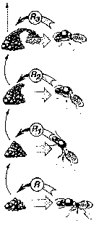
Stigmergy Example
Pillar construction in termites
Notes:
39
So this could be the point where termites are killed and the picture on page 18 is instead used and described with respect to ants...
Watch the last sentence it is already in the previous slide...!@!!!!!

Slide 40
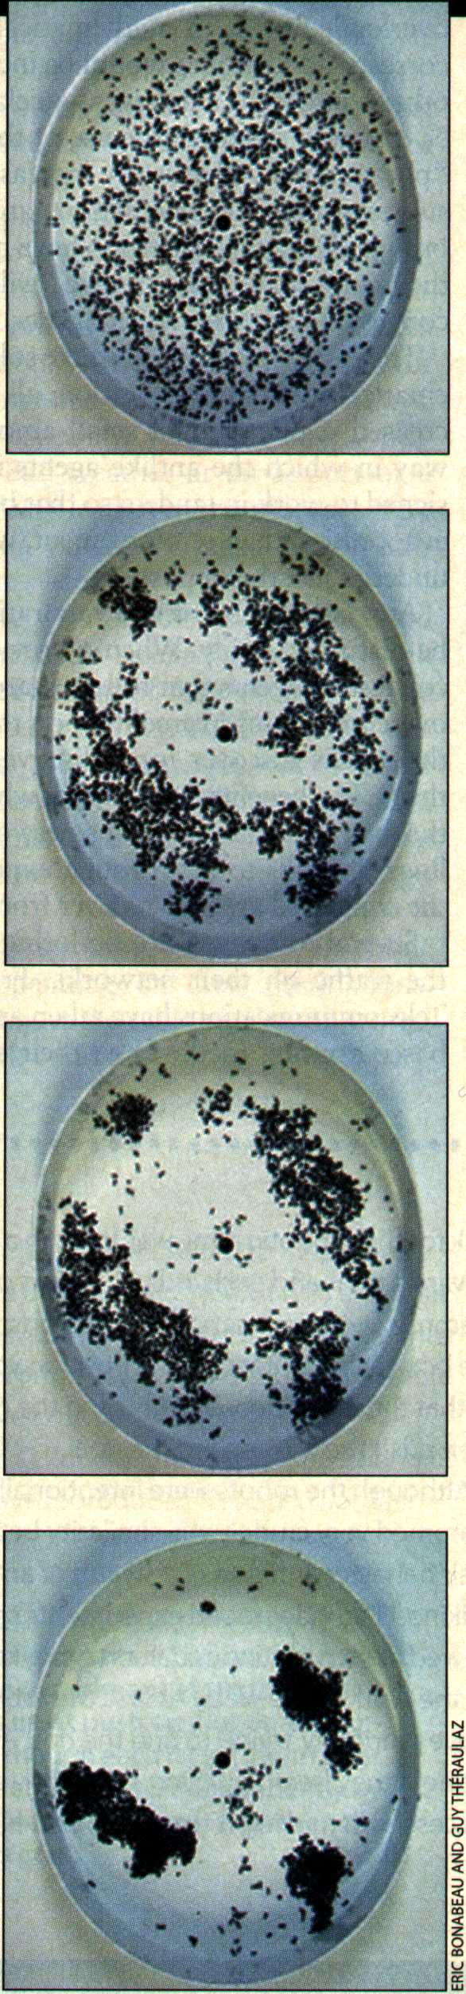
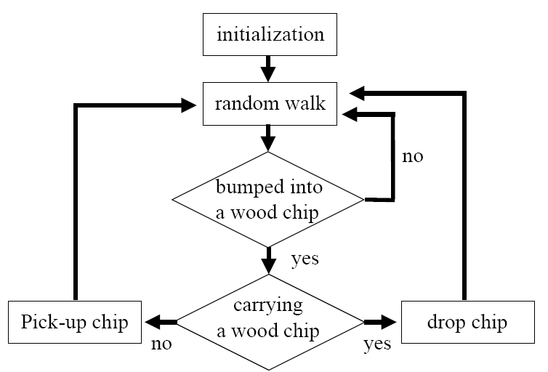
Stigmergy in Action

Slide 41
Ants ≡ Agents
Stigmergy can be operational
Coordination by indirect interaction is more appealing than direct communication
Stigmergy reduces (or eliminates) communications between agents, people learning from role-models
Notes:
41
talk about termite example
incremental construction
flexibility - agents respond to perturbations of the environment.
Indirect communication is more appealing: agents are not as dependant on each other (they can leave cues behind for the next agent)

Slide 42
From Insects to Realistic A.I. Algorithms

Slide 43
From Ants to Algorithms
Swarm intelligence information allows us to address modeling via:
Problem solving
Algorithms
Real world applications

Slide 44
Modeling
Observe Phenomenon
Create a biologically motivated model
Explore model without constraints

Slide 45
Modeling...
Creates a simplified picture of reality
Observable relevant quantities become variables of the model
Other (hidden) variables build connections
Notes:
45
What does the last point mean?

Slide 46
A Good Model has...
Parsimony (simplicity)--KISS rule Keep it simple & stupid
Coherence:explain past observations,predict future observations
Refutability:Enabling estimation of the degree of confidence in the model
Parameter values correspond to values of their natural counterparts
Notes:
46
Parsimony, Coherence, Refutability : Page 17 text

Slide 47
Welcome to the Real World

Slide 48
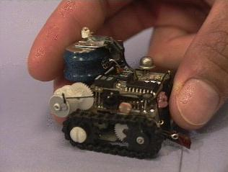
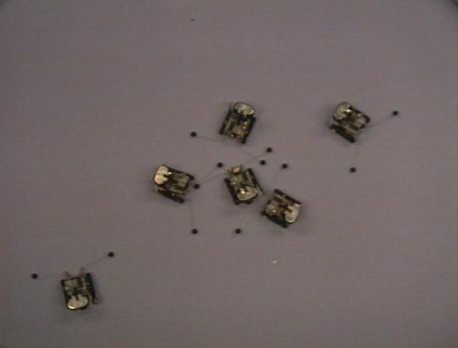
Robots
Collective task completion
No need for overly complex algorithms
Adaptable to changing environment

Slide 49
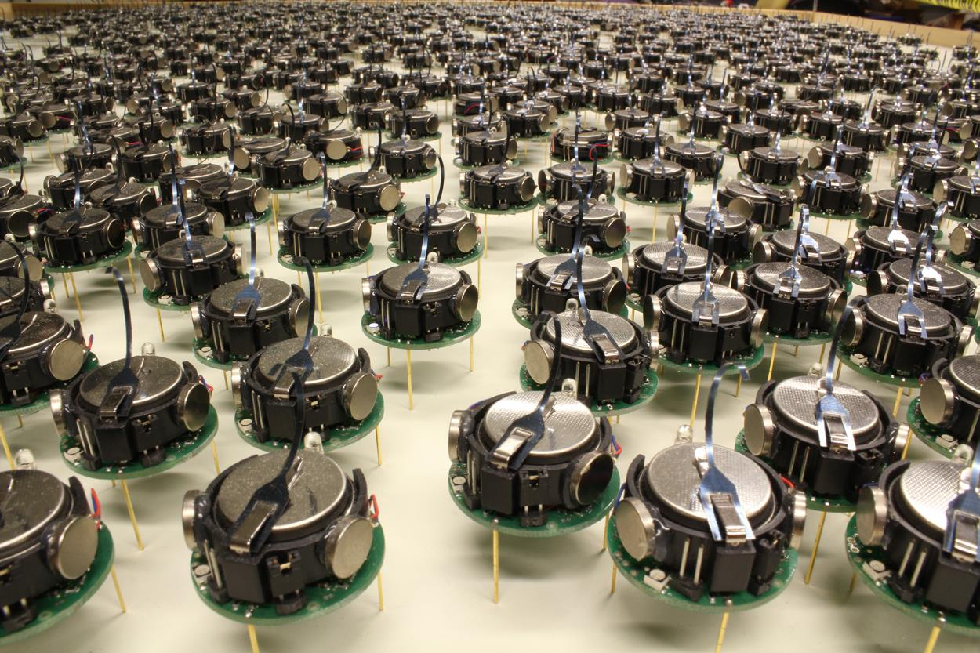
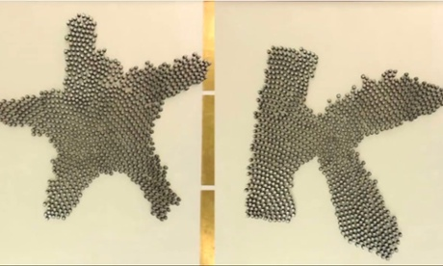
Kilobot
"Programmable Self-Assembly in a Thousand-Robot Swarm", Michael Rubenstein, Alejandro Cornejo, Radhika Nagpal, Science, Vol 345, no 6198, 15 Aug 2014

Slide 50

Termite-Inspired Robot
(A and B) Complex meter-scale termite mounds (A) are built by millimeter-scale insects (B), which act independently with local sensing and limited information. (C) Physical implementation of our system, with independent climbing robots that build using specialized bricks. (D) System overview for building a specific predetermined result
"Designing Collective Behavior in a Termite-Inspired Robot Construction Team",Justin Werfel, Kirstin Petersen, Radhika Nagpal,Science, Vol 343, no 6172, 14 Feb 2014

Slide 51

Self-assembling Robot

Slide 52

Swarm Intelligence and Traffic Safety
A smart car that assists the driver must give warnings in dangerous situations, override the driver to avoid collisions, and help to reach the intended destination as quickly as possible.

Slide 53
Communication Networks
Routing packets to destination in shortest time
Similar to Shortest Route
Statistics kept from prior routing (learning from experience)

Slide 54

Shortest Route
Congestion
Adaptability
Flexibility

Slide 55
Closing Arguments
Still very theoretical
No clear boundaries
Details about inner workings of insect swarms
The future…???

Slide 56


Dumb parts, properly connected into a swarm, yield smart results. Kevin Kelly
Founding editor of Wired magazine
大众智慧、云计算、物联网、虚拟现实、敏捷开发、协作、双赢、共生、共同进化、网络社区、网络经济
《 Out of Control 》1994

Slide 57
The Future?
Miniaturization
Telecommunications
Cleaning Ship Hulls
Medical
Pipe Inspection
Satellite Maintenance
Self-Assembling Robots
Engine Maintenance
Job Scheduling
Pest Eradication
Combinatorial Optimization
Interacting Chips in Mundane Objects
Data Clustering
Vehicle Routing
Distributed Mail Systems
Optimal Resource Allocation

